Slide 1



Churn - dashboard powerBi
View in Power BI
Last data refresh:
3/16/2020 10:17:29 AM Romance Standard Time
Downloaded at:
3/16/2020 10:41:58 AM Romance Standard Time

Slide 2
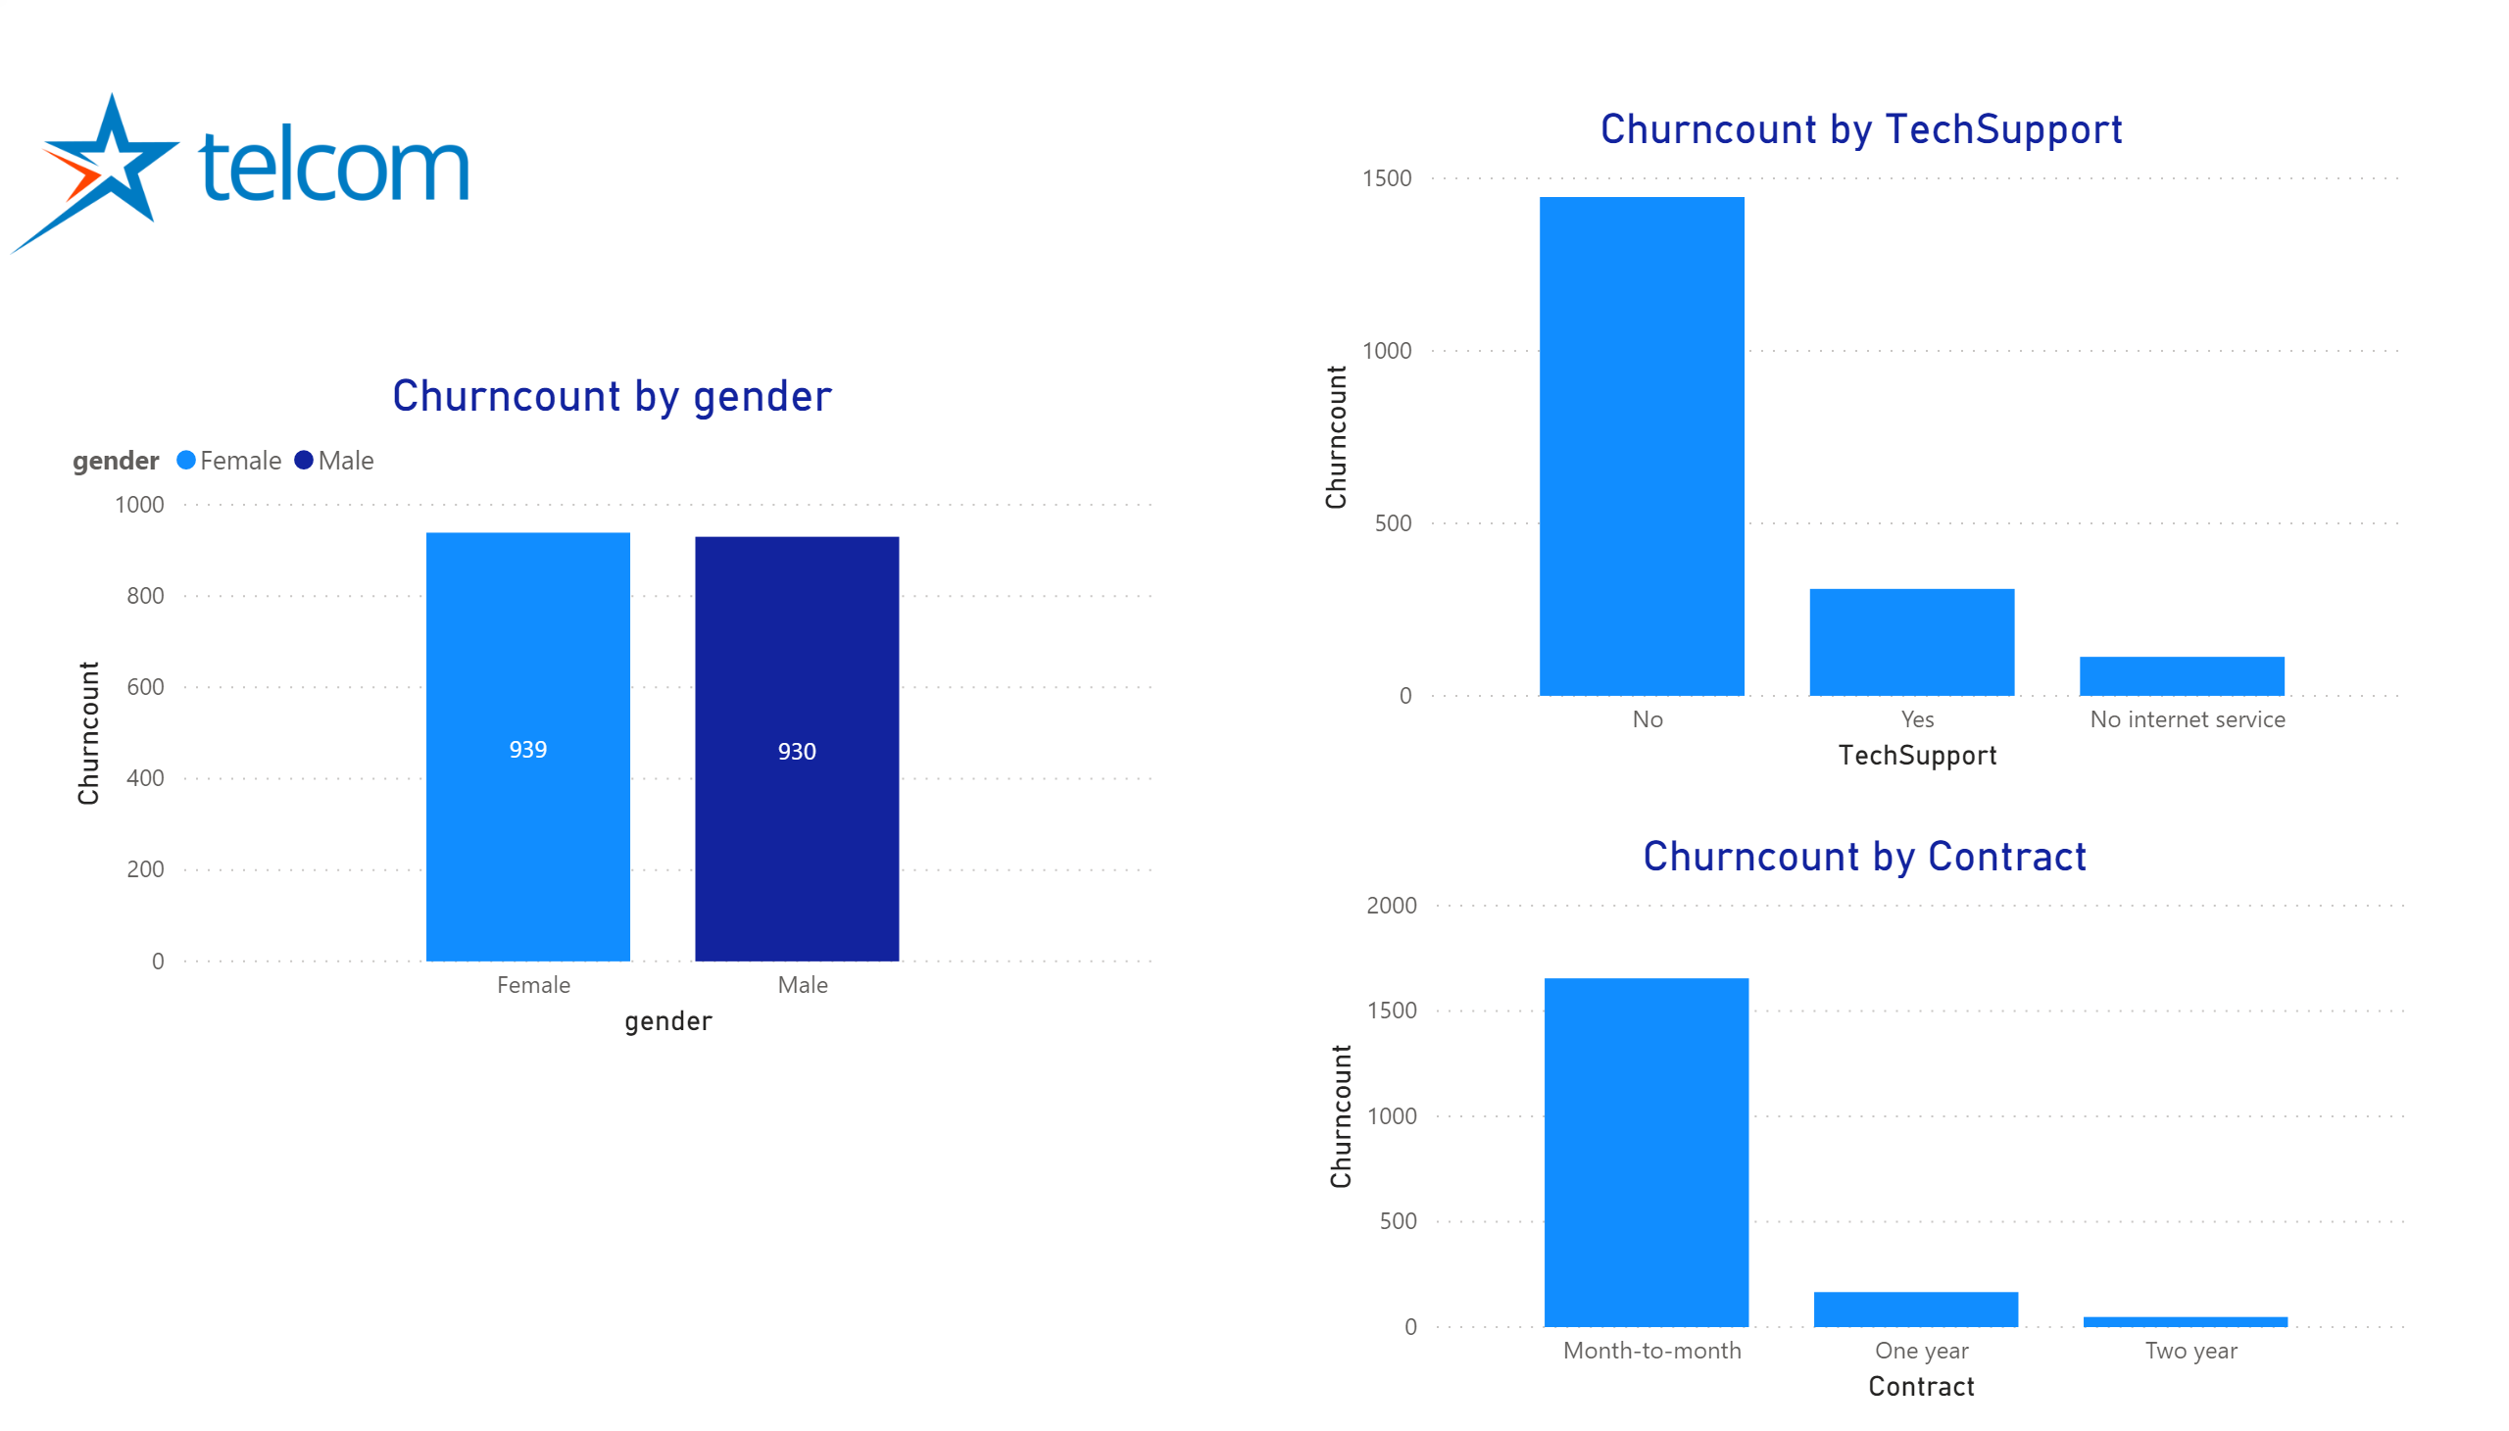

Slide 3
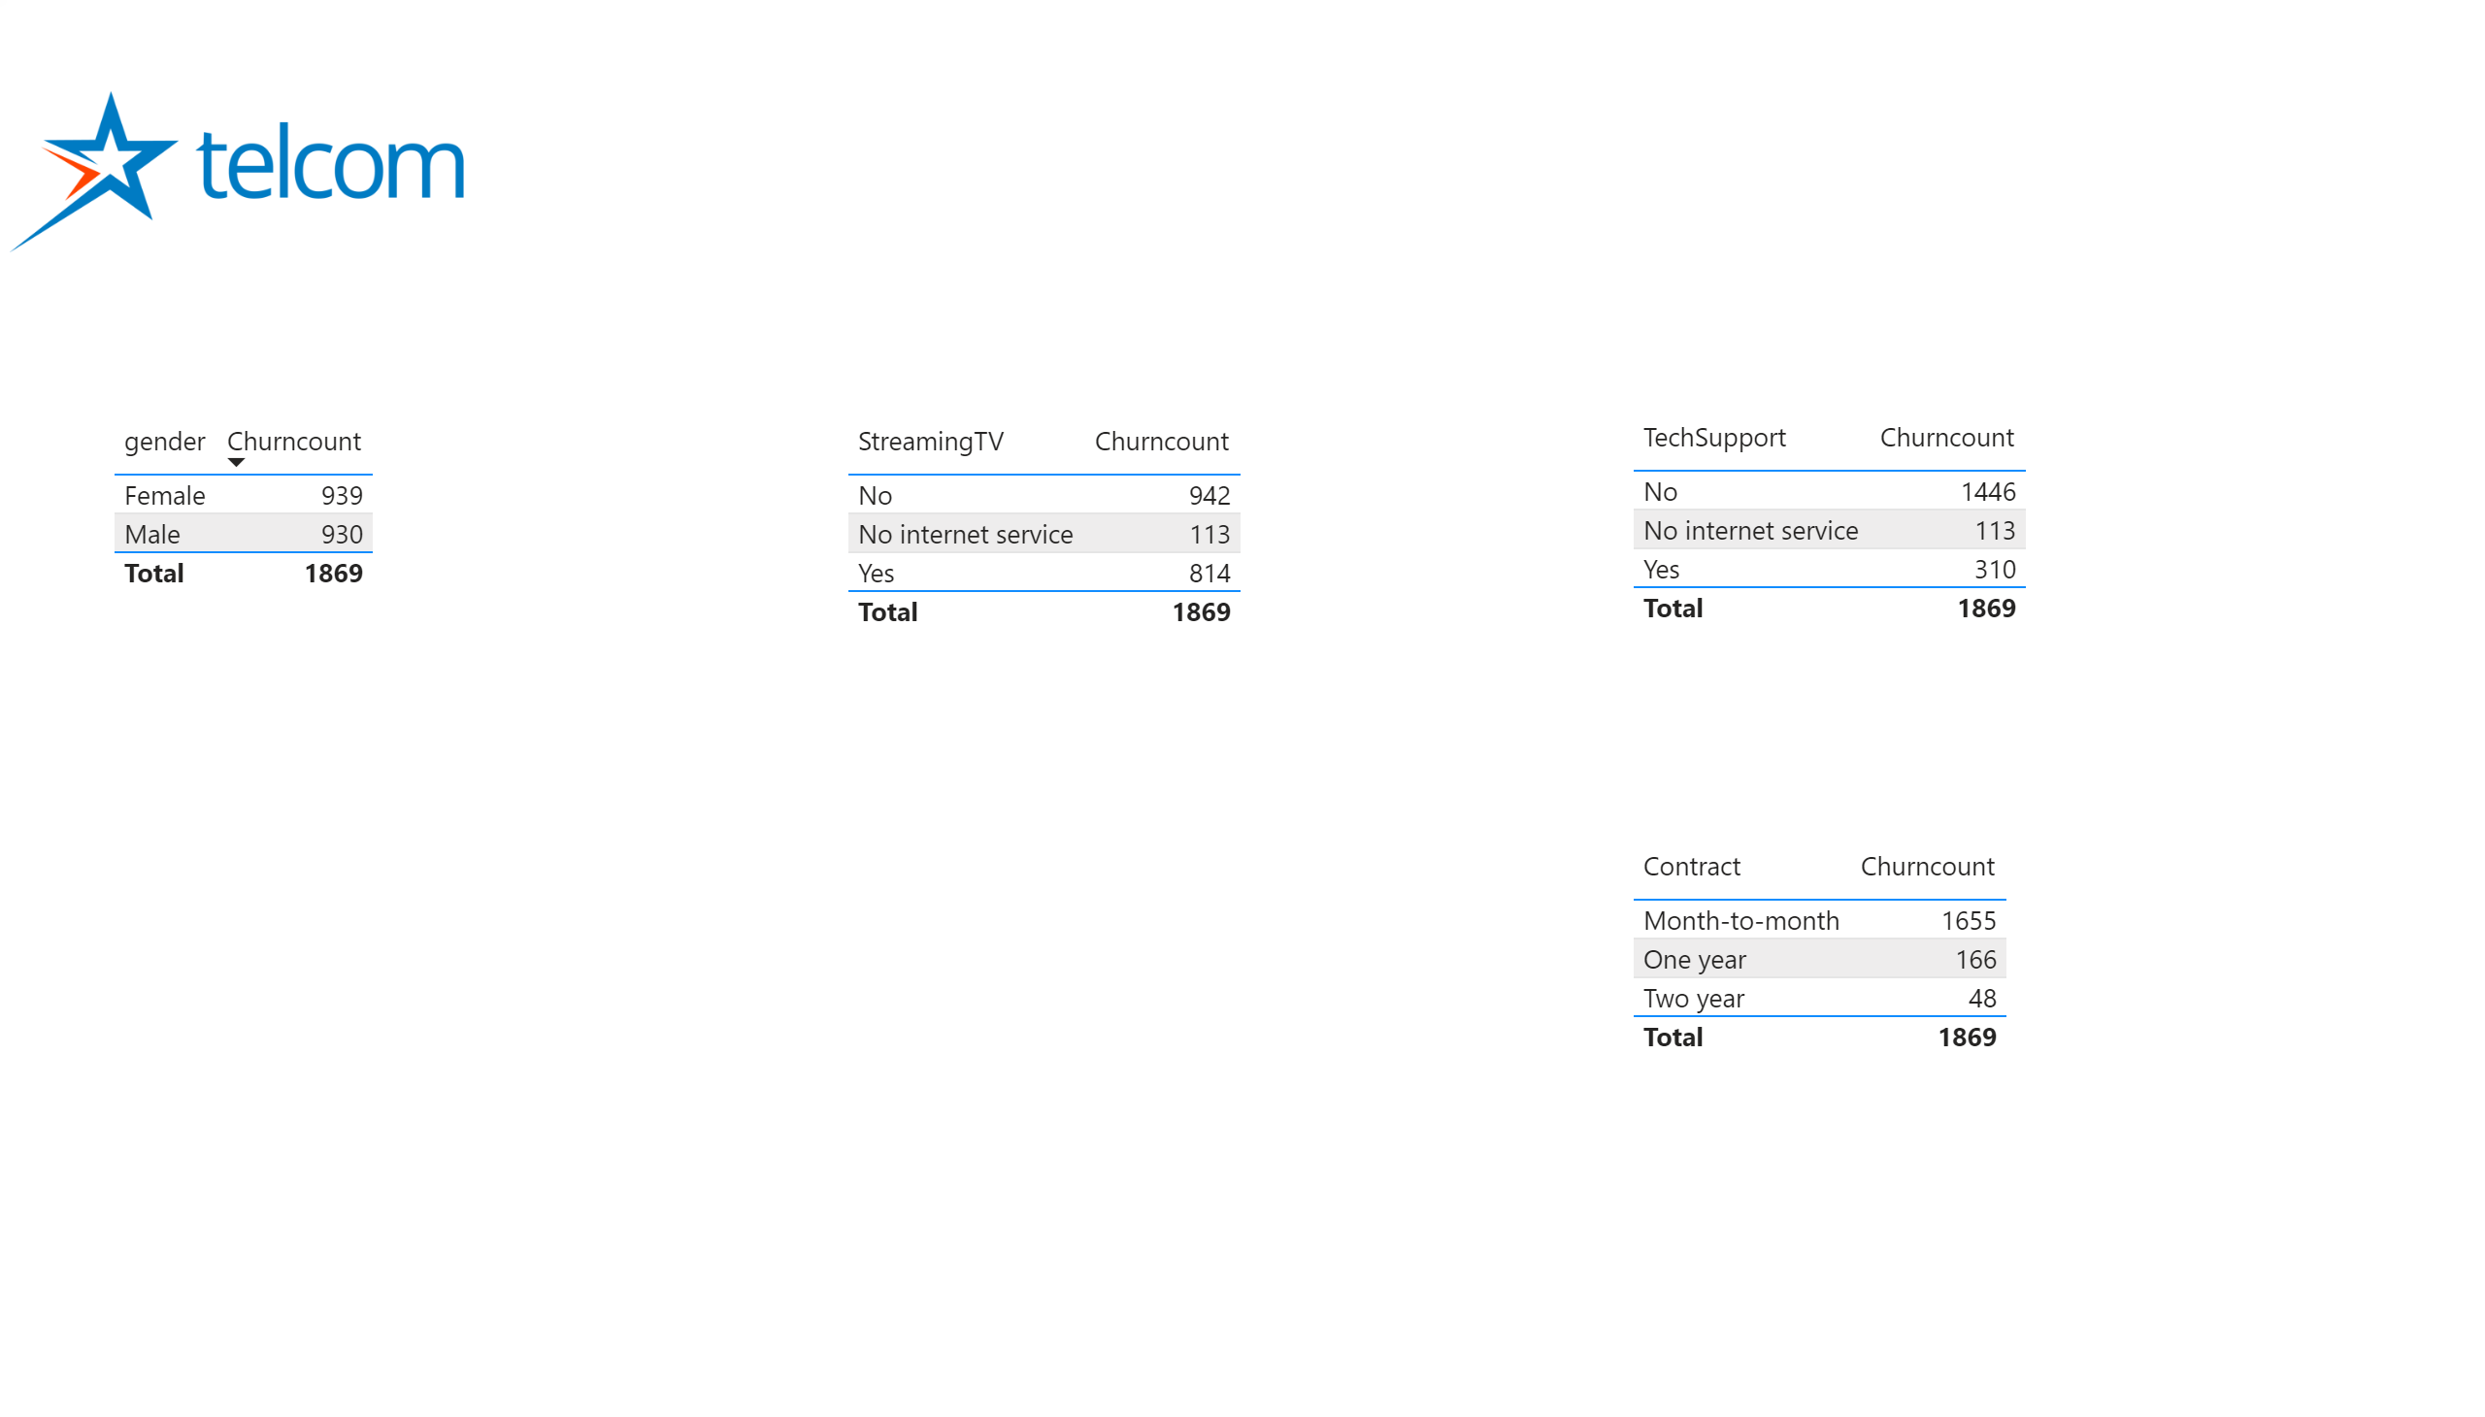

Slide 4
